Slide 1
API - Overview
2025
Poornima

Slide 2
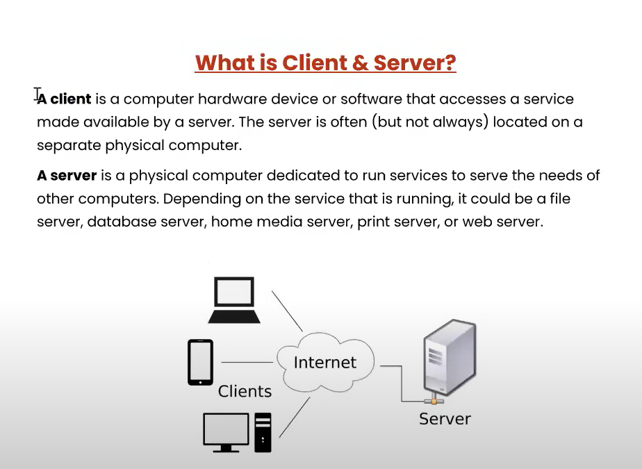
Client & Server

Slide 3
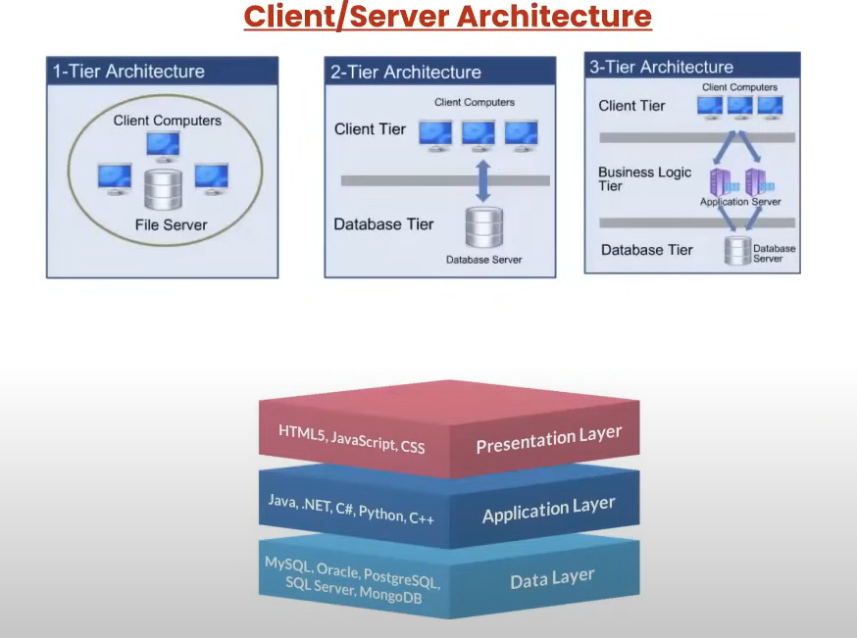
Client/Server Architecture

Slide 4
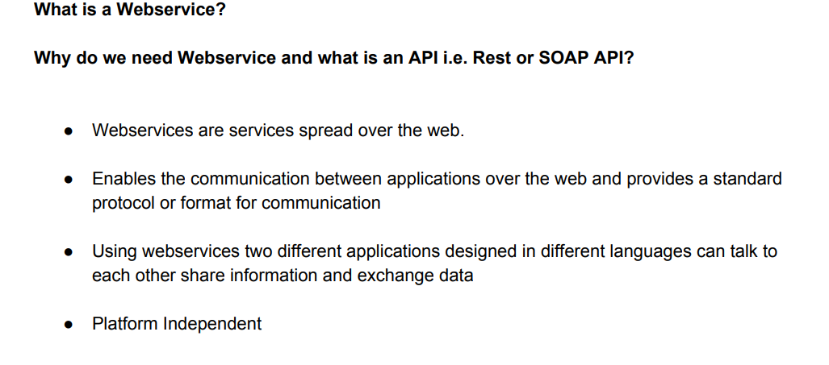
WebService /API

Slide 5
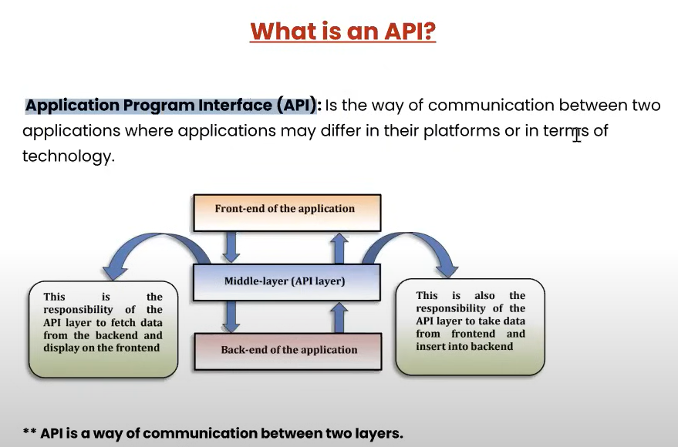
API

Slide 6
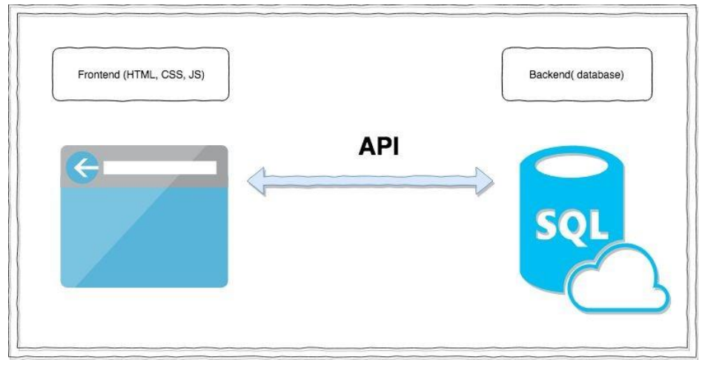
API
API stands for the Application Programming Interface, They are basically a collection of functions and procedures which allows us to communicate two application or library.

Slide 7
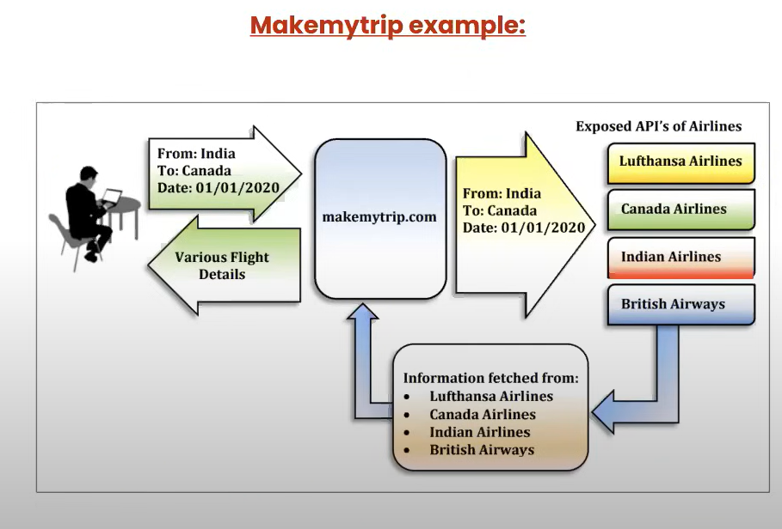
API

Slide 8
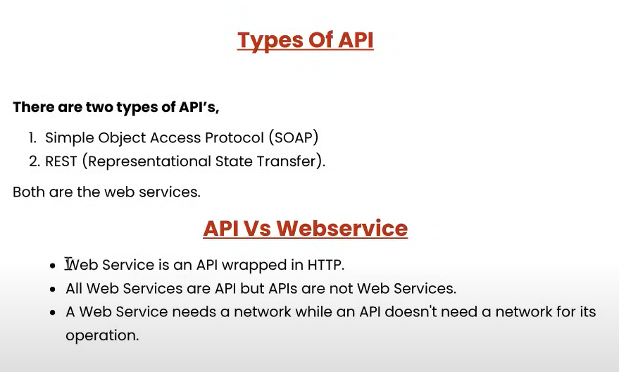
API
SOAP (Simple Object Access Protocol):- Where the Medium HTTP(POST) and FORMAT XML.
REST (Representational State Transfer):- Where Medium HTTP(GET, POST,PUT,DELETE, etc.) and FORMAT XML/JSON/TEXT etc

Slide 9
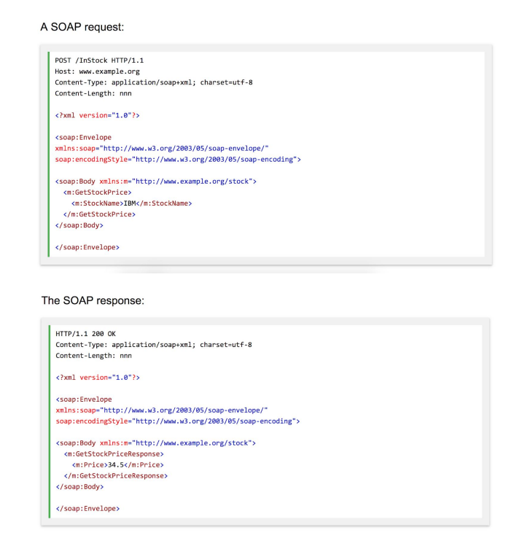
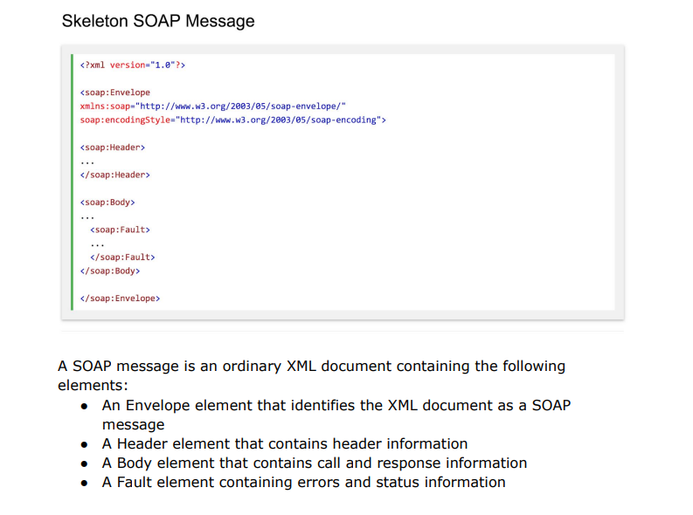
SOAP

Slide 10
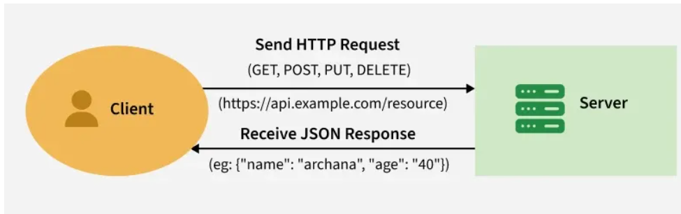
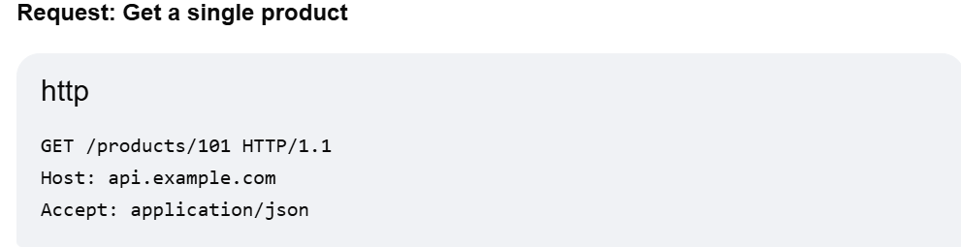
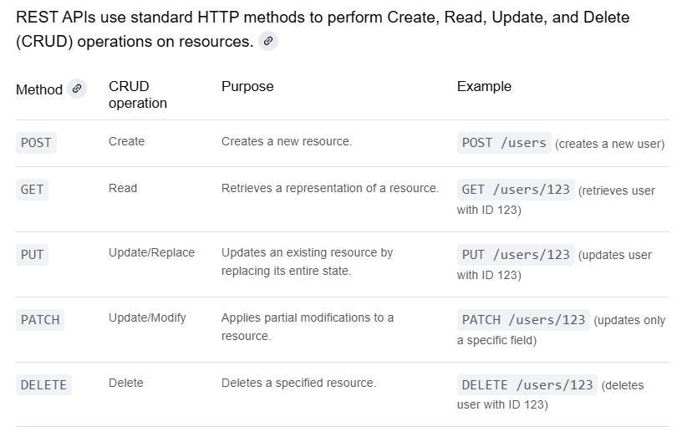
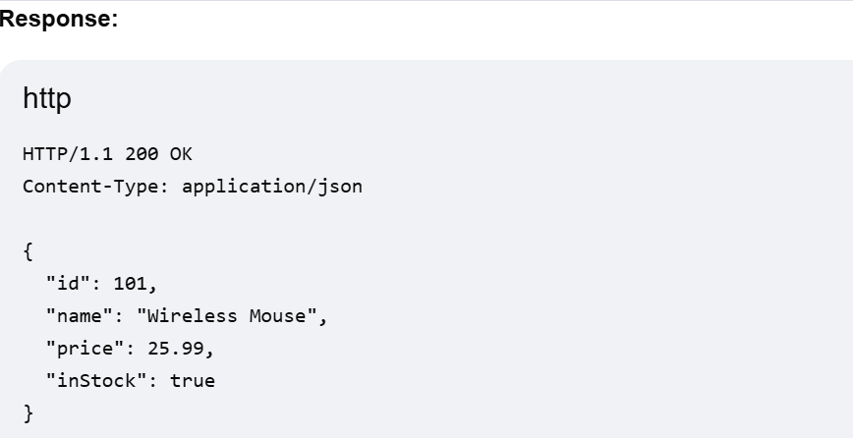
REST API
Method: GET
URI: /products/101 targets the specific resource with ID 101.
Headers: The Accept header specifies that the client expects a JSON response.
Status: 200 OK indicates that the request was successful.
Headers: The Content-Type header confirms that the response body is in JSON format.
Body: The JSON object contains the data for the requested product.

Slide 11
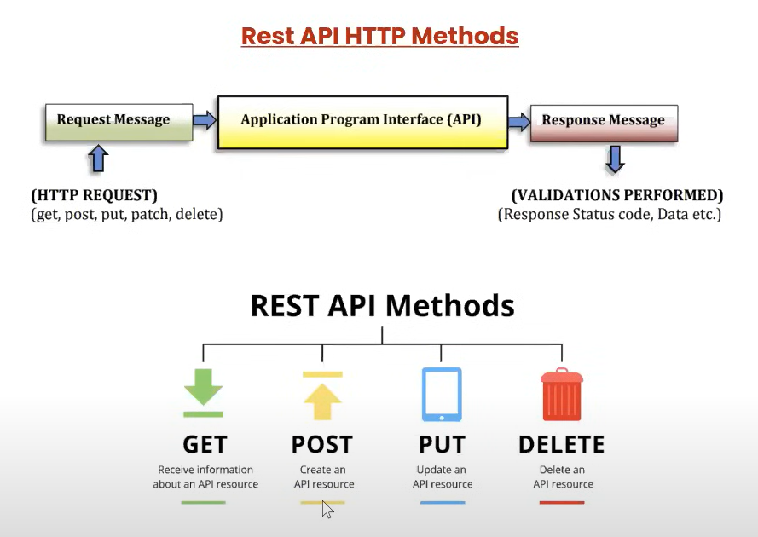
REST API

Slide 12
REST API – HTTP Response Codes
Category | Code Range | Examples | Meaning
Informational | 100–199 | 100 Continue, 101 Switching Protocols | Request received, continue process
Success | 200–299 | 200 OK, 201 Created, 204 No Content | Request successfully processed
Redirection | 300–399 | 301 Moved Permanently, 302 Found, 304 Not Modified | Client must take further action
Client Error | 400–499 | 400 Bad Request, 401 Unauthorized, 403 Forbidden, 404 Not Found | Error caused by client’s request
Server Error | 500–599 | 500 Internal Server Error, 502 Bad Gateway, 503 Service Unavailable

Slide 13
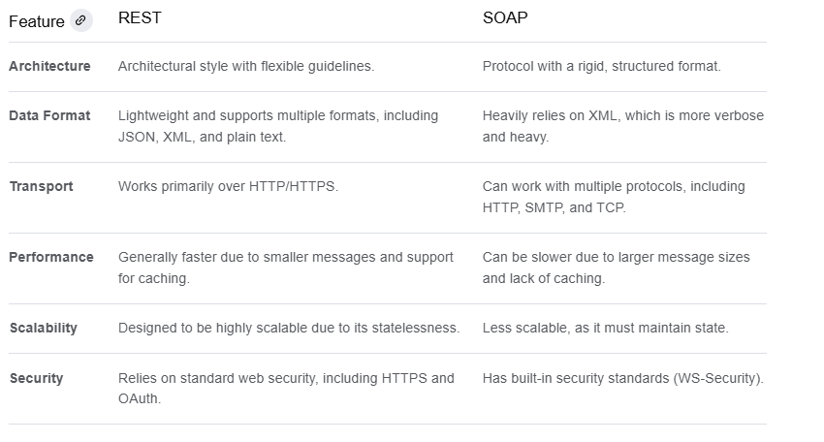
REST Vs SOAP

Slide 14
Why API Testing?
Ensures data is exchanged correctly between systems.
Detects issues early (before UI is built).
Faster and more stable than UI testing.
Essential for microservices and modern apps.

Slide 15
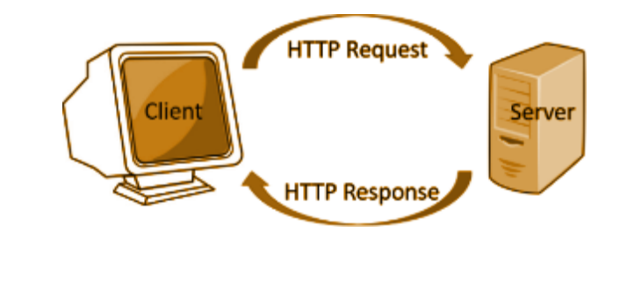
HTTP - fundamentals
HTTP is an application layer protocol designed within the framework of the Internet protocol suite.
There is Client which perform a request resource which can be HTMLPage, file extra from Server and server perform the response to the client back using the same protocol known as HTTP.
HTTP is a stateless protocol. In other words, the current request does not know what has been done in the previous requests

Slide 16
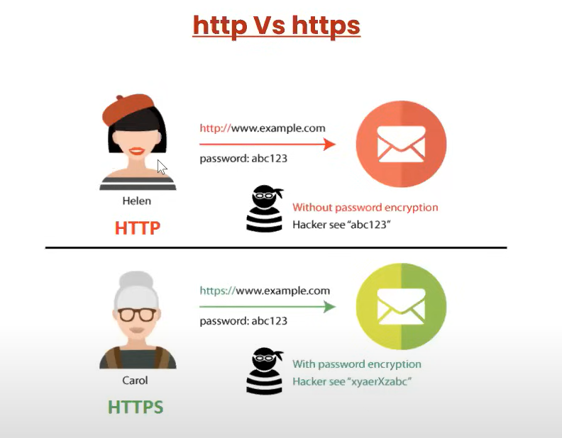
HTTP - fundamentals

Slide 17
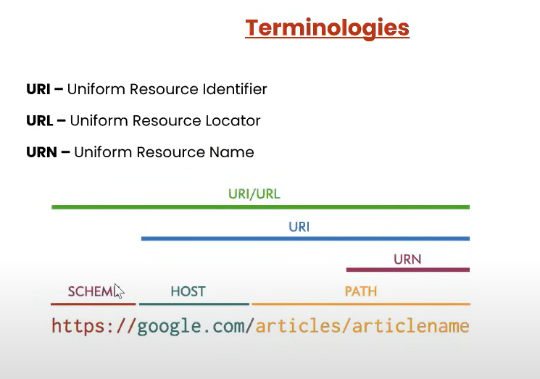
Terminologies

Slide 18
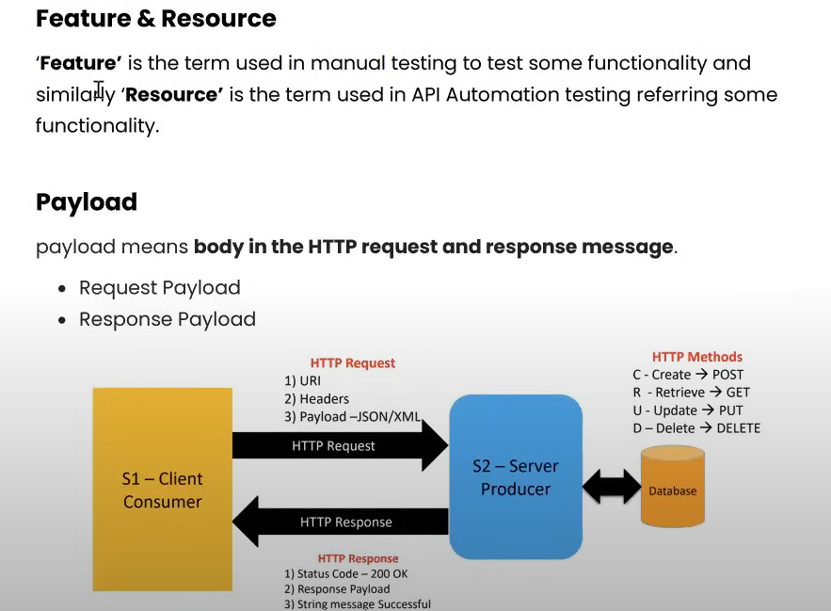
Terminologies

Slide 19
API Testing Tools
SoapUI
Postman
Rest Assured
Katalon Studio
Apache JMeter

